Slide 1

Amazon Co-Purchased Metadata Analysis
Addisalem Kebede

Slide 2
Technology Used
Notes:
NetworkX: Python package for creating and analyzing complex networks
AWS CLI: AWS Command Line Interface
Needed to work with DynamoDB locally

Slide 3
What did I do?

Slide 4
NoSQL Database
Recommendation System

Slide 5
NoSQL Database
Product Table
Review Table
Notes:
What did I want in each table?
How do I want the data to be structured?

Slide 6
NoSQL Database: Product Table
ASIN *
Group **
Id
Title
Sales rank
Similar
Categories
Average review rating
Total number of reviews
Primary Key = *
Group Key = **

Slide 7
NoSQL Database: Review Table
ASIN *
Customer ID **
Title
Rating
Votes
Helpful
Date
Primary Key = *
Group Key = **

Slide 8
Data Set
Products: 548,552
Reviews: 7,781,990
Books: 393,561
DVDs: 19,828
Music CDs: 103,144
Videos: 26,132

Slide 9
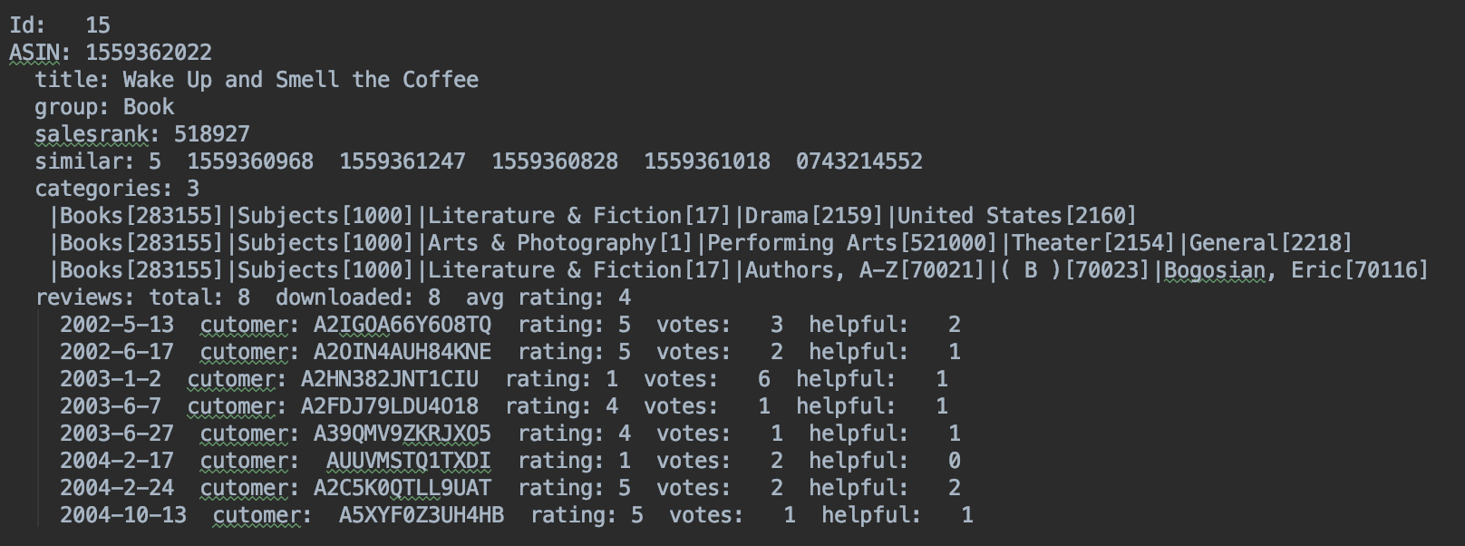
Original Data Format

Slide 10
Parsed & Inserted Data
Notes:
Got rid of discontinued items

Slide 11
Preset Queries
1. Query all reviews for a product.
2. Query all reviews for a given customer.
3. Query product information.
4. Query reviews for a product that have a helpful score > min score.
5. Query the average review of a product.
6. Query products of a category.
7. Query co-purchased products.
8. Query reviews for a product that has a votes score > min votes.
9. Query products of a group.
10. Query Titles.
11. Query products with average review rating between min rating and max rating.
12. Query the products that are part of a group with an average rating > min rating

Slide 12
Recommendation System

Slide 13
Graph
Nodes: Product ASIN
Edges: Co-purchased products
Weight: Cosine similarity of categories

Slide 14
Parsed & Inserted Data
Notes:
Got rid of discontinued items,
Items with no co-purchase history

Slide 15
Search Based on ASIN

Slide 16
Result
Co-purchased items recommended based on similarity level

Slide 17

Questions?

